Slide 1
LUNG VOLUMES AND CAPACITIES, DEAD SPACE
Dr. Tabish Masood Ranjha

Slide 2


Volumes Versus Capacities
There are four volume subdivisions which:
do not overlap.
can not be further divided.
when added together equal total lung capacity.
Lung capacities are subdivisions of total volume that include two or more of the 4 basic lung volumes.
Notes:
3

Slide 3
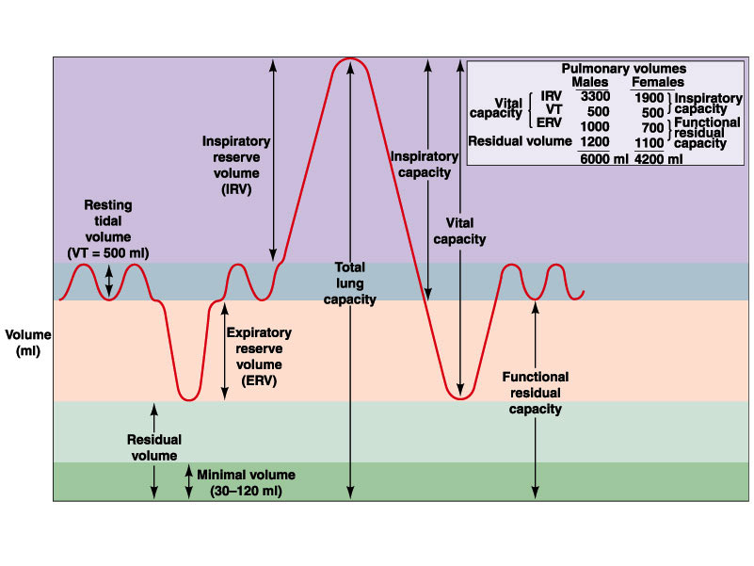
Spirometer and Lung Volumes/Capacities

Slide 4
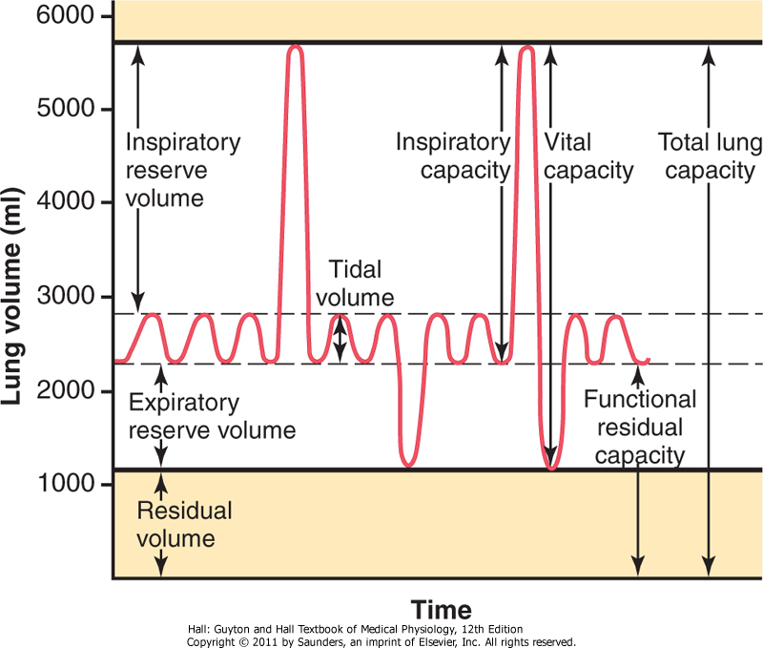

Slide 5
LUNG VOLUMES AND CAPACITIES
V_{T} = Tidal volume= 500 ml
IRV = Inspiratory Reserve Volume= 3000ml
ERV = Expiratory Reserve Volume= 1100ml
RV = Residual Volume= 1200 ml
VC = Vital Capacity= 4600 ml
(V_{T} + IRV + ERV )
FRC = Functional residual capacity= 2300 ml
(RV + IRV )
IC = Inspiratory Capacity= 3500 ml
(V_{T} + IRV )
TLC = Total lung capacity= 5800ml
( VC + RV )

Slide 6
Tidal Volume (TV)
Volume of air inspired and expired during normal quiet breathing
IRV
IC
VC
TLC
TV
ERV
FRC
RV
RV

Slide 7
Inspiratory Reserve Volume (IRV)
The maximum amount of air that can be inhaled after a normal tidal volume inspiration
IRV
IC
VC
TLC
TV
ERV
FRC
RV
RV

Slide 8
Expiratory Reserve Volume (ERV)
Maximum amount of air that can be exhaled from the resting expiratory level
IRV
IC
VC
TLC
TV
ERV
FRC
RV
RV

Slide 9
Residual Volume (RV)
Volume of air remaining in the lungs at the end of maximum expiration
IRV
IC
VC
TLC
TV
ERV
FRC
RV
RV

Slide 10
Vital Capacity (VC)
Volume of air that can be exhaled from the lungs after a maximum inspiration
FVC: when VC exhaled forcefully
VC = IRV + TV + ERV
IRV
IC
VC
TLC
TV
ERV
FRC
RV
RV

Slide 11
Inspiratory Capacity (IC)
Maximum amount of air that can be inhaled from the end of a tidal volume
IC = IRV + TV
IRV
IC
VC
TLC
TV
ERV
FRC
RV
RV

Slide 12
Functional Residual Capacity (FRC)
Volume of air remaining in the lungs at the end of a TV expiration
FRC = ERV + RV
IRV
IC
VC
TLC
TV
ERV
FRC
RV
RV

Slide 13
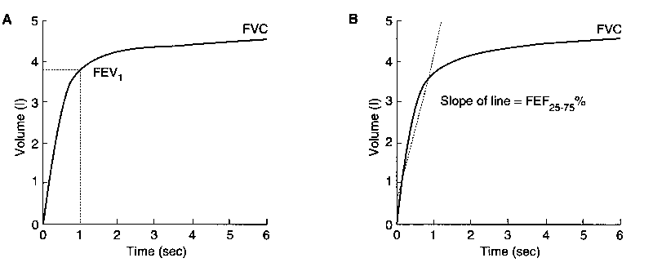
Forced Spirometry ( FEV1 , FEV1/FVC )
Forced vital capacity (FVC):
Total volume of air that can be exhaled forcefully after a forceful inspiration
can be exhaled in <3 seconds in normal people, but prolonged in obstructive diseases
Measured in liters (L)

Slide 14
Forced expiratory volume in 1 second: (FEV₁)
Volume of air forcefully expired from full inflation (TLC) in the first second
Measured in liters (L)
more than 75-80% of FVC in the first second;
the FEV1/FVC utilized to characterize lung disease

Slide 15
Total And Alveolar Ventilation
TOTAL VENTILATION/ MINUTE VOLUME
Volume of air entering or leaving lungs each minute
V = Respiration rate x Tidal volume
12 x 500ml = 6 L / min
ALVEOLAR VENTILATION
Volume of fresh air entering each minute into the respiratory zone
V A = Respiratory rate x ( V T – V D )
V T = tidal volume = 500ml
V D = dead space volume = 150 ml
V A = 12 x ( 500 – 150 )
= 4.2 L min

Slide 16
ALVEOLAR VENTILATION
Determines O₂ and CO₂ concentration in alveoli (PO₂ , PCO₂)
Slow rate of renewal of alveolar air 50% in 17 seconds
Influenced by rate and depth of breathing
Also influenced by dead space volume
Hypoventilation -decreasedO₂, increased CO₂
Hyperventilation-increased O₂, decreased CO₂

Slide 17
Minute and Alveolar Ventilation
Minute ventilation: Total amount of air moved into and out of respiratory system per minute
Respiratory rate or frequency: Number of breaths taken per minute
Alveolar ventilation: How much air per minute enters the parts of the respiratory system in which gas exchange takes place

Slide 18
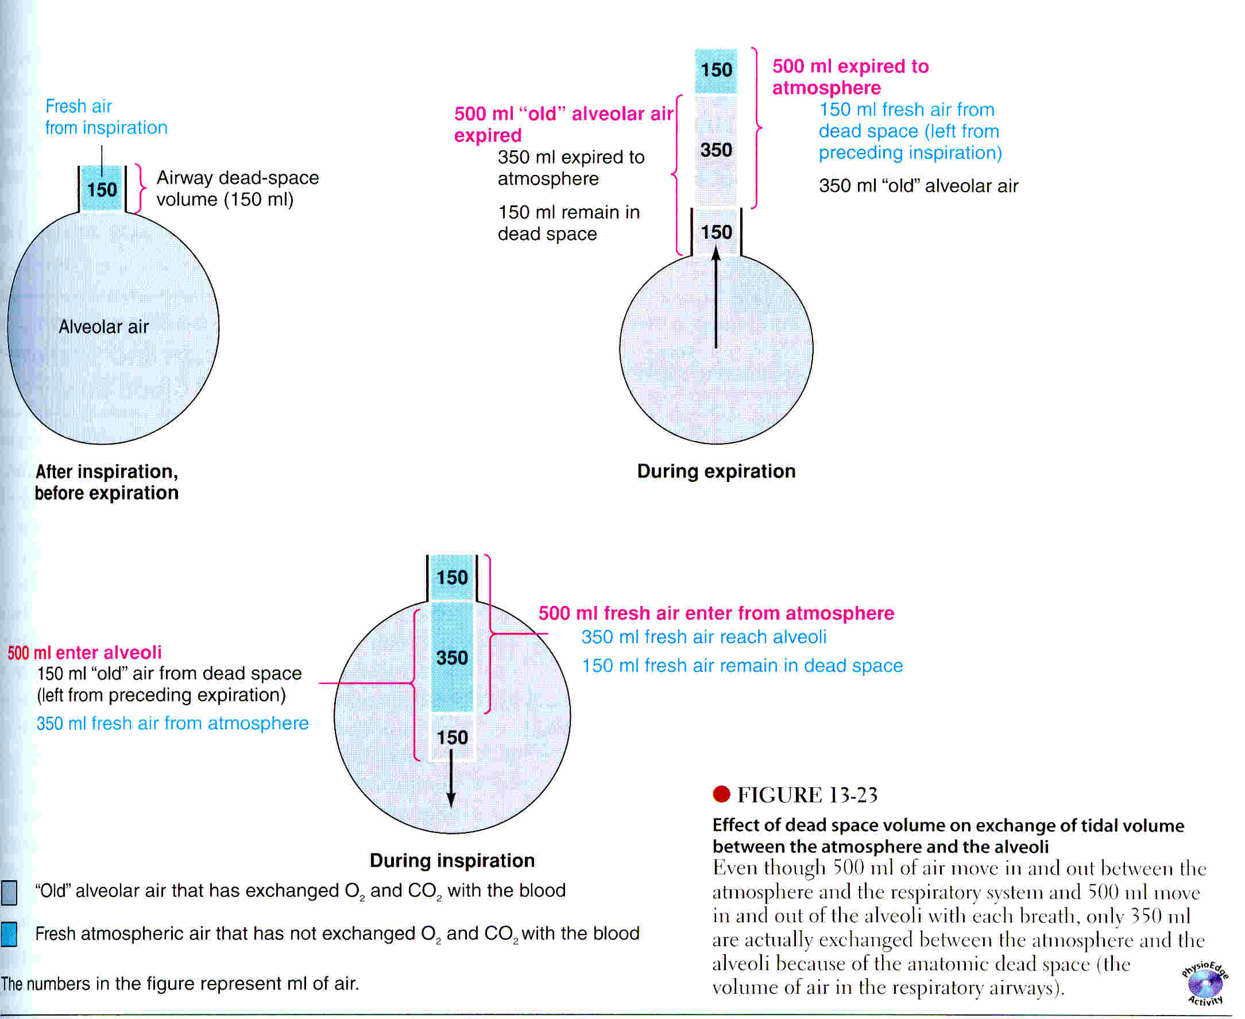

Slide 19
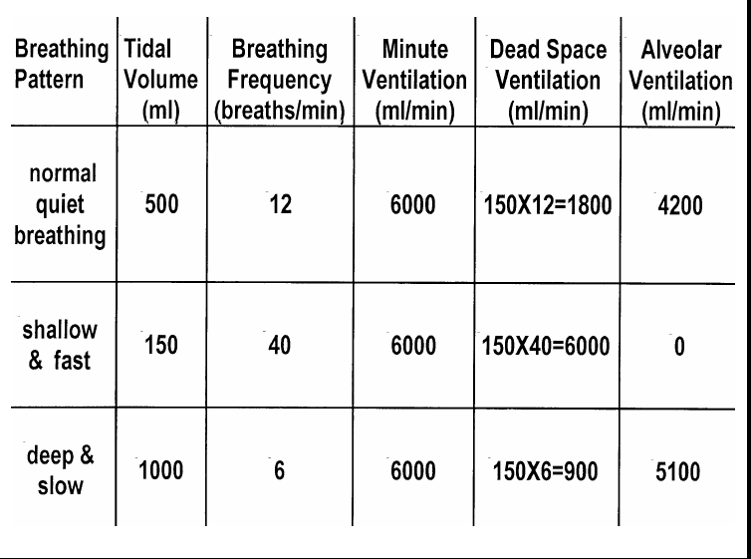

Slide 20
Definitions of Dead Space
Anatomic Dead Space
Physiologic Dead Space
Low Blood Flow
Copyright © 2006 by Elsevier, Inc.

Slide 21

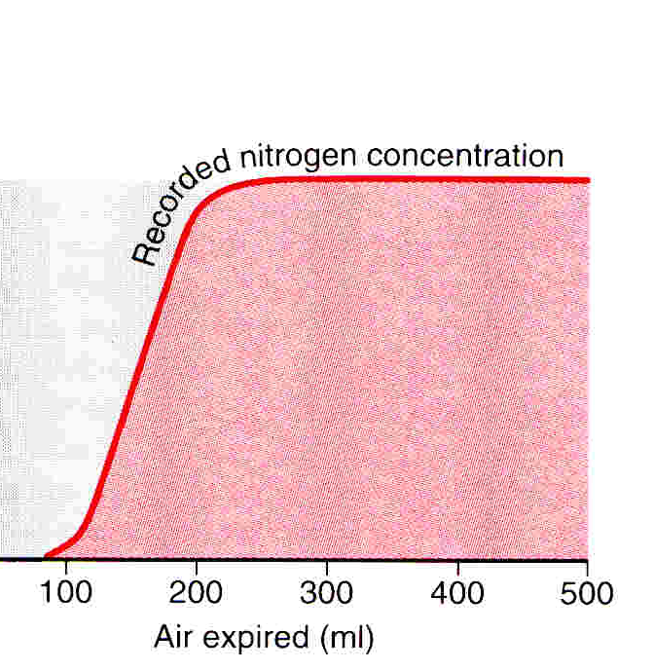
MEASUREMENT OF DEAD SPACE (FOWLER’S METHOD)
Deep breath of O₂ ,then expire through rapidly recording nitrogen meter
V_{D}= Area without N₂ x vol of air expired
Area with N₂ + Area without N₂
= 30 x 500
70+30
= 150 ml
SIGNIFICANCE V_{D} may increase 10 times in pulmonary diseases.

Slide 22
